Slide 1
Mathematics & Statistics Graduate Programs
Fall 2023

Slide 2
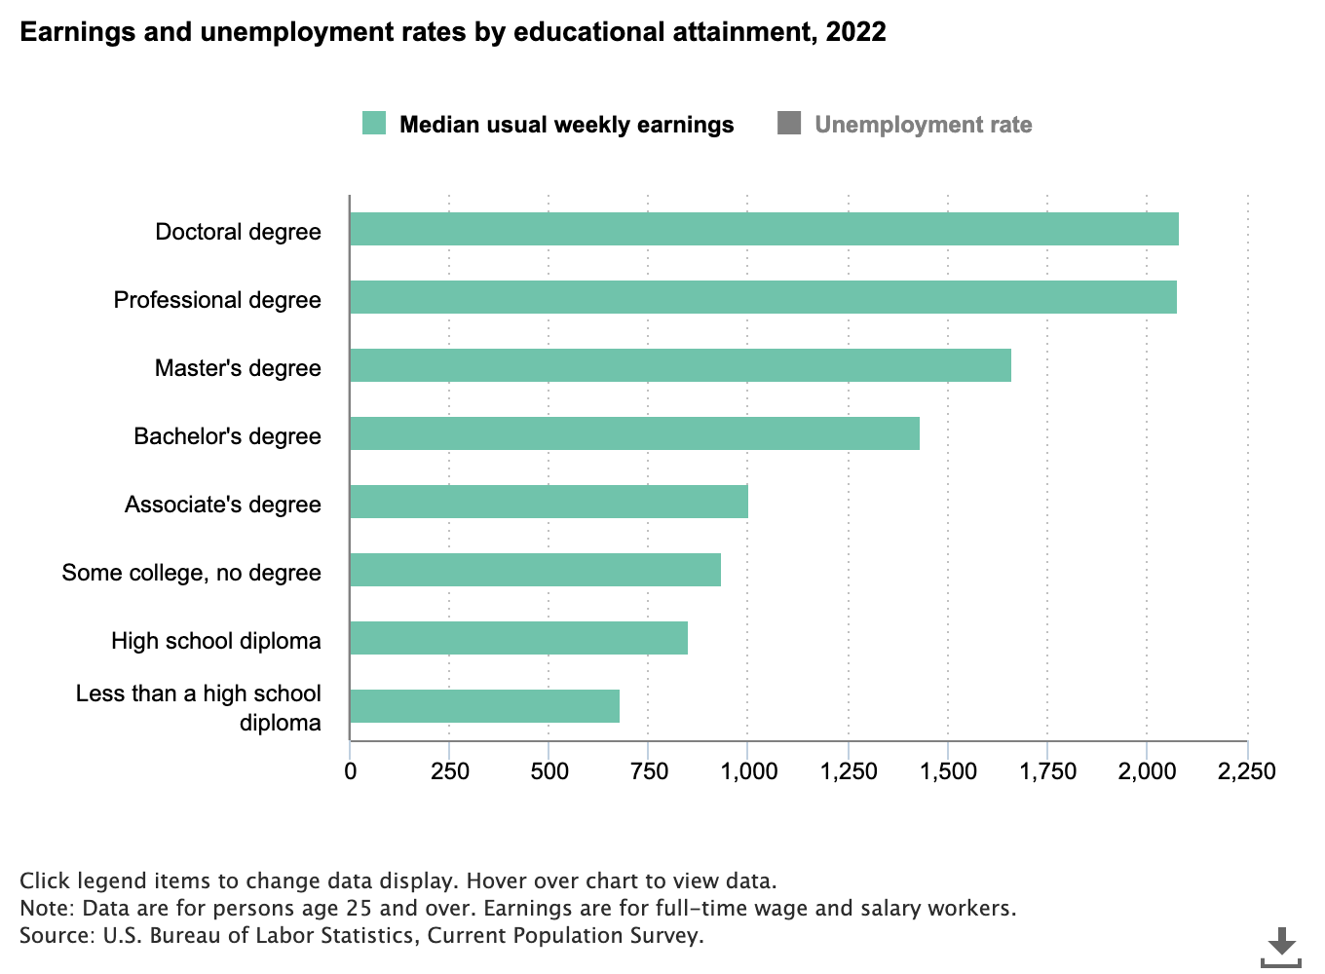
Why a graduate degree?
A substantially higher salary -- According to the Bureau of Labor Statistics (BLS), advanced degree holders in general earn a much higher annual salary than those with a bachelor’s degree alone.

Slide 3
Why a graduate degree?
Increased job satisfaction: Research has found that education can have a significant and positive effect on overall job satisfaction.
While there is extensive research that shows increased job satisfaction among those with a bachelor’s degree or higher, several specific studies have identified a correlation between increased job satisfaction and advanced degrees.

Slide 4
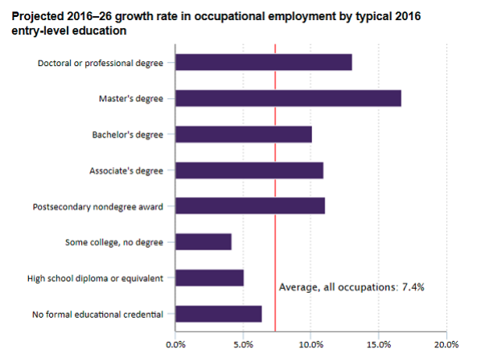
Why a graduate degree?
More and better job options--According to BLS, occupations that typically require a master’s degree are projected to grow at a rate of 16.7 percent through 2026, compared to 7.4 percent projected growth rate for all other occupations.

Slide 5
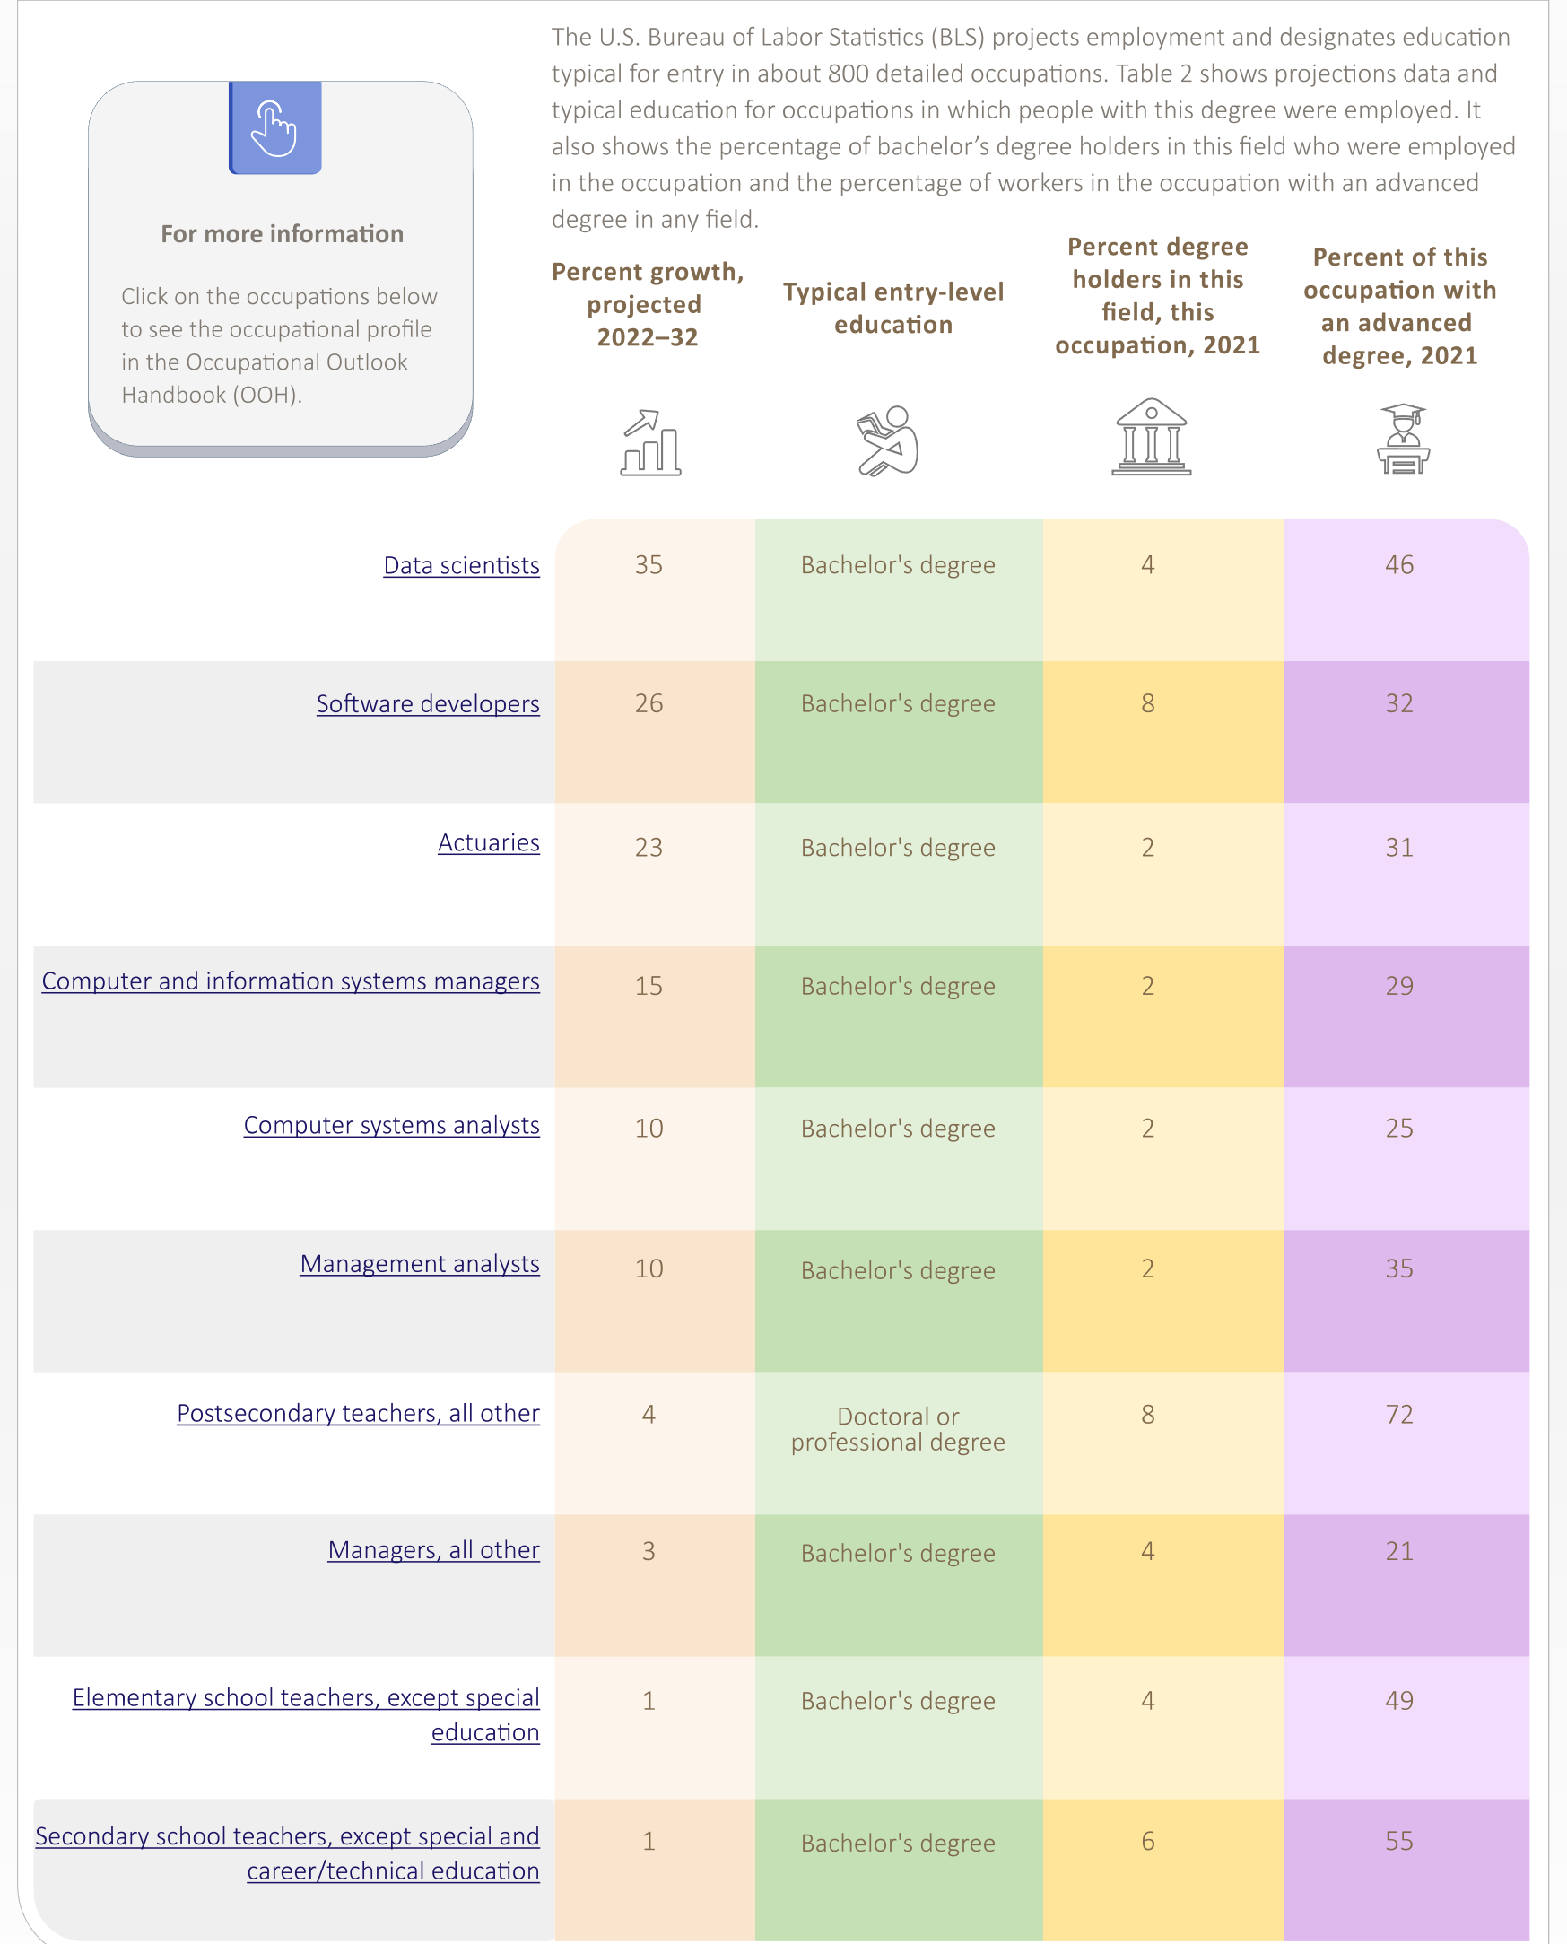
Top Employing Occupations for Workers with a Math Degree

Slide 6
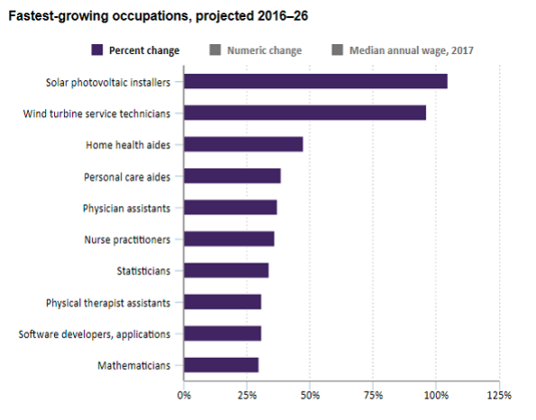
Why a graduate degree in Math/Stat?
Mathematics and Statistics are among the top fastest growing occupations!

Slide 7
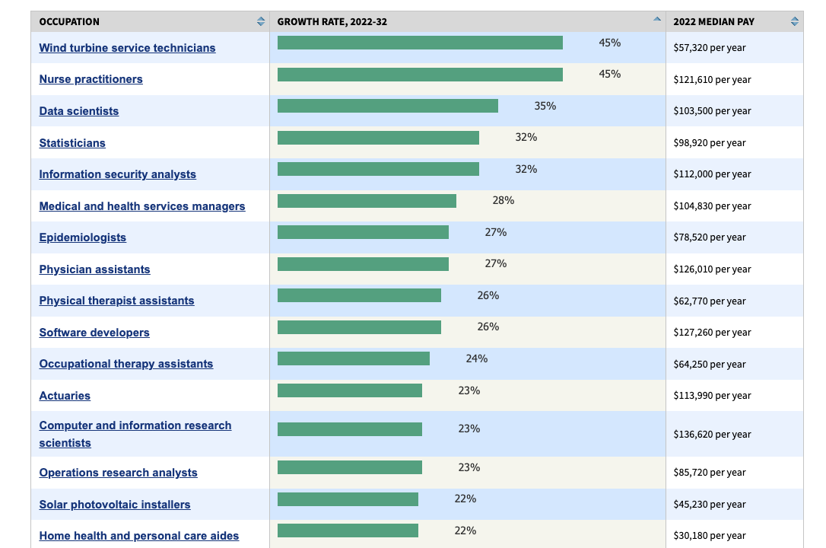
Fastest Growing Occupations
20 occupations with the highest projected percent change of employment between 2022-32.

Slide 8
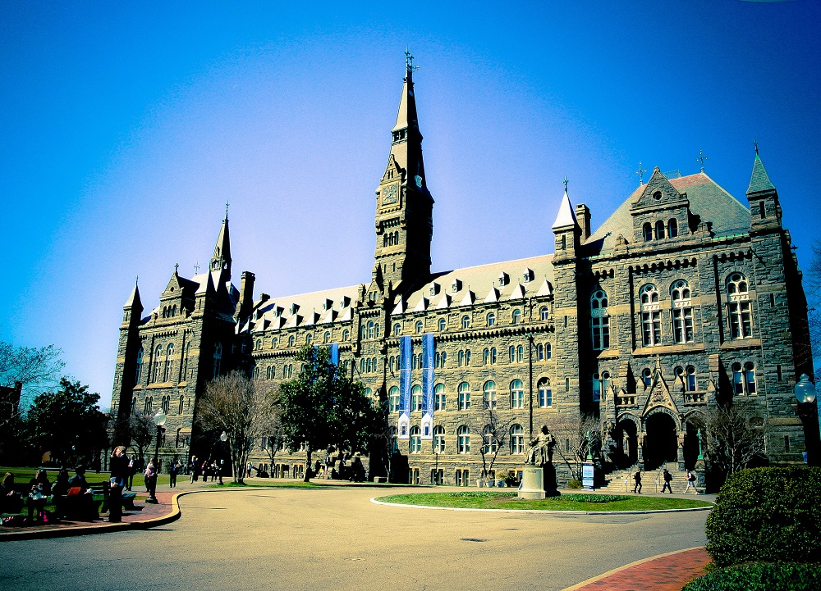

Slide 9
Graduate Programs
MS in Mathematics and Statistics (since Fall 2006)
Accelerated program option for advanced Math majors
PhD in Applied Mathematics (Since Fall 2022)

Slide 10

the MAST Program

Slide 11
About the MAST Program
The primary mission of the MS degree program in Mathematics and Statistics is to prepare students for professional careers in disciplines which make use of the mathematical and statistical sciences.
First class in the fall semester of 2006 with stable growth over the past 17 years.
Strong job placement track record. Our graduates have advanced to Government agencies, NGOs, and the private sector.
Read more about the program on the program website.

Slide 12
Degree Requirements*
30 credits required
1 elective from outside MAST program
4 core courses
5051, 5052, 5151, 5152
3.0 GPA to graduate
3 years to complete degree
MS program has no thesis requirements
*MAST Graduate Handbook & The Graduate School Bulletin

Slide 13
List of MAST Courses
Core Courses:
MATH 5051 Probability Theory and Applications
MATH 5052 Deterministic Mathematical Models
MATH 5151 Mathematical Statistics
MATH 5152 Numerical Methods
Elective Courses:
MATH 5007 Mathematics of Climate
MATH 5001 Longitudinal Data Analysis
MATH 5005 Mathematics of Social Networks MATH 5011 Partial Differential Equations
MATH 5014 Optimization
MATH 5060 Survey Sampling
MATH 5061 Experimental Design of Experiments
MATH 5070 Introduction to Non-Parametric Statistics
MATH 5200 Mathematical and Statistical Computing
MATH 5210 Advanced Mathematical and Statistical Computing

Slide 14
List of MAST Courses
MATH 5310 Deep Learning
MATH 5320 Introduction to Statistical Learning
MATH 5330 Data Mining
MATH 5340 Social Network Analysis
MATH 5420 Financial Mathematics
MATH 5410 Introduction to Operations Research
MATH 5500 Linear Regression Models
MATH 5510 Generalized Linear Models
MATH 5520 Time Series
MATH 5530 Applied Multivariate Analysis
MATH 5600 Bayesian Statistics
MATH 5700 Numerical Optimization
MATH 5710 Stochastic Simulation

Slide 15
Accelerated MS Program
Available for GU Math majors only!
May obtain a BS and MS in 5 years!
MS can be earned in two semesters after completing requirements for the AB or BS.
May double count 2 courses (6 credits)
May satisfy up to 40% of the course requirements in Senior year, and complete the remaining 60% in the 5th year
For more details:
https://mathstat.georgetown.edu/undergraduate/five-year-program

Slide 16
Accelerated MS Program
Eligibility and Requirements:
Must be a Math major at Georgetown
Must have an overall GPA of 3.5 or higher, no C grades in math/stat courses and more A’s than B’s.
When to Apply?
Apply in Junior year
Interested students should contact the Director of Undergraduate Studies early in their junior year and should also discuss their plans with their undergraduate advisor.

Slide 17
PhD Program
PhD in Applied Mathematics launched in Fall 2022
Currently accepting applications for Fall 2024
Students must be full-time; tuition is covered and stipend provided
27 credits required
4 core courses (Real Analysis, Advanced Linear Algebra, Numerical Analysis, and Complex Analysis)
3.0 GPA on courses required for PhD candidacy
For more details:
https://mathstat.georgetown.edu/phd-program

Slide 18
Any questions?
Please feel free to reach out to
Prof. Arab (DGS)
Dean Leong (GPC)

